Slide 1
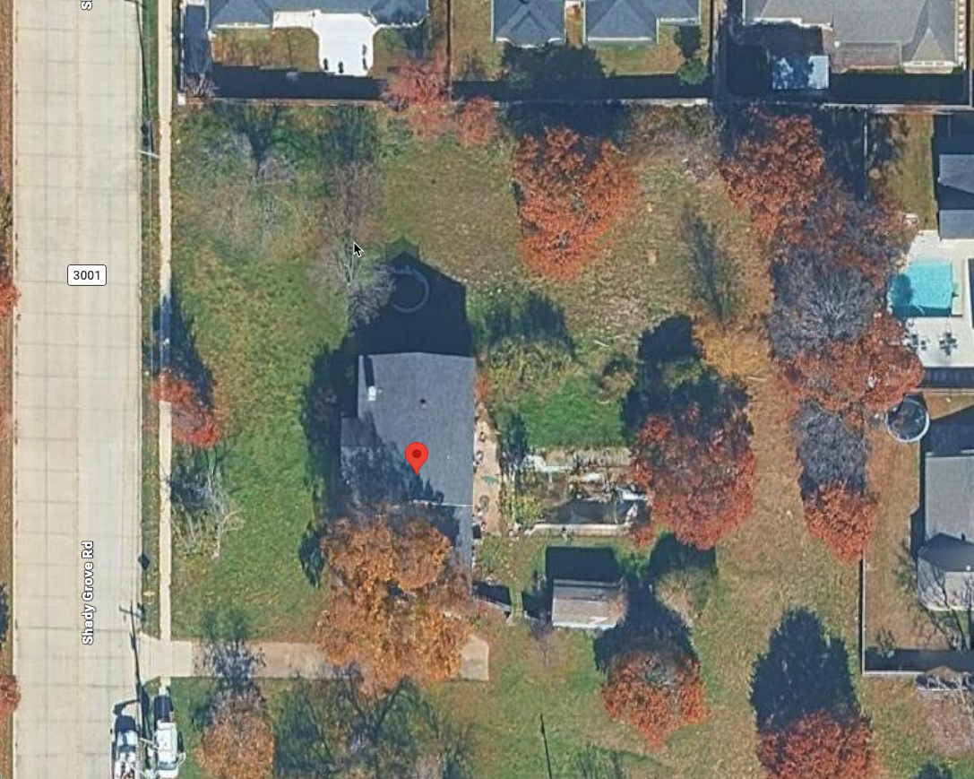

Drainage Concerns
8459 Shady Grove Rd
North Richland Hills, TX 76182
A resident-focused review of potential stormwater impacts from added roof area, hard surface, and changed grading.
Request: engineered drainage review before final approval
Scan to download
Prepared for City staff, Planning & Zoning, City Council, and affected residents
1
Notes:
Frame the presentation as a request for verification and mitigation, not as a final engineering finding. Emphasize that residents are asking for a sealed drainage review, updated grading plan, and runoff controls before approval or final inspection.

Slide 2
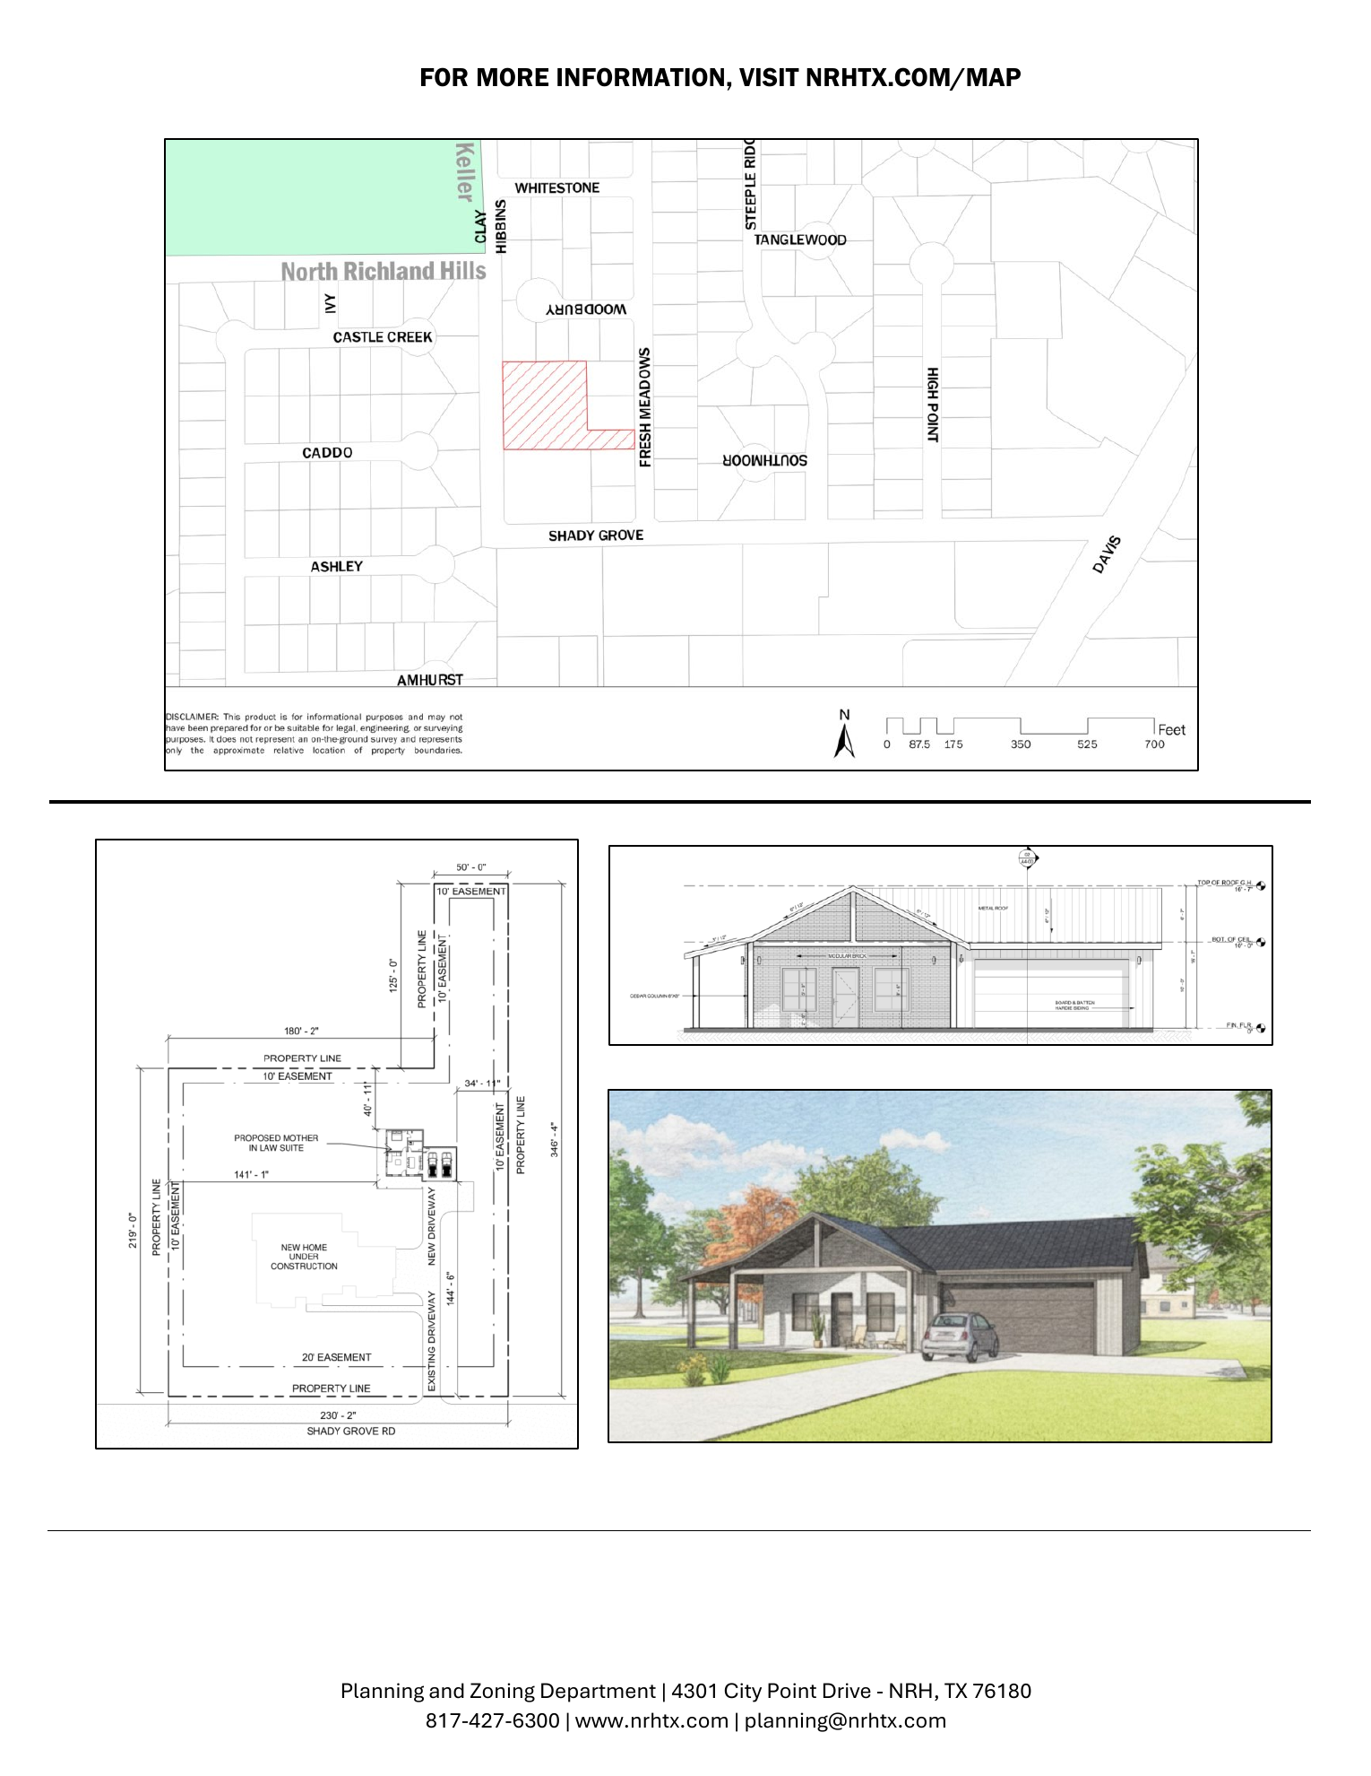
What is being requested by the applicant
Case ZC26-0169: Special Use Permit for a secondary living unit / detached garage accessory structure.
Key facts from the City notice
Applicant: RAA Real Estate Investing LLC.
Request: Special Use Permit for a secondary living unit.
Accessory structure: 1,988 SF total; 798 SF living area; 477 SF covered porches; two-car garage.
Property: 1.319 acres, Lot 1, Block 1, Merritt Addition.
Public hearings: Planning & Zoning July 16, 2026; City Council August 10, 2026.
Core question:
Does the proposed work preserve the approved drainage pattern and prevent concentrated runoff toward neighboring lots?
Official case facts and site exhibit: Reference [8].
2
Notes:
This slide establishes the official case context and sizes from the City notice. Avoid arguing land use merits; keep the focus on drainage and grading conditions attached to any approval.

Slide 3
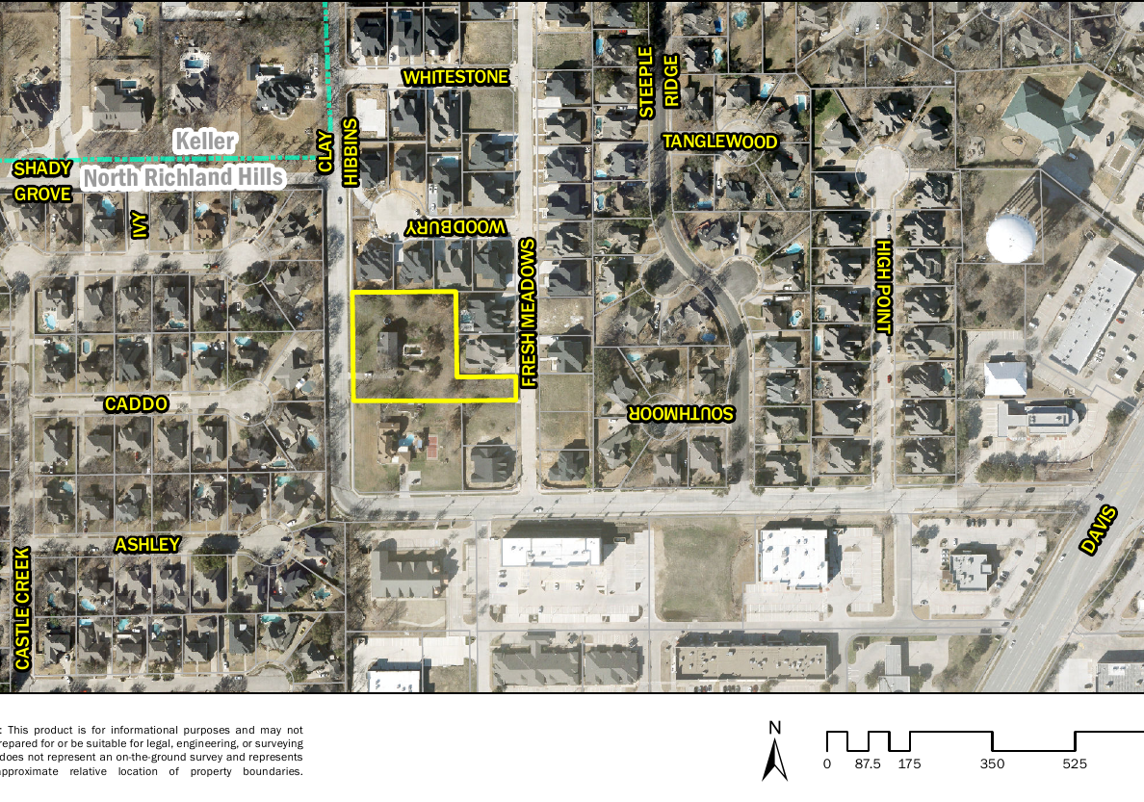
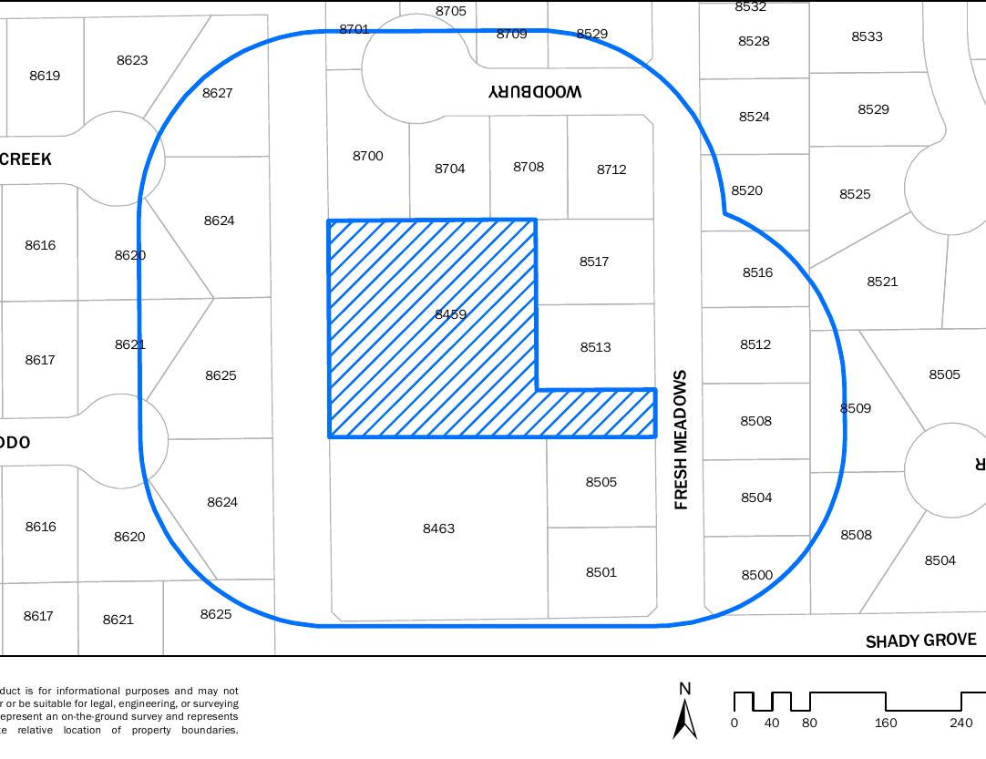
The site is large, but drainage risk is local
The concern is not just total acreage — it is where roof runoff, driveway runoff, and regraded surface flow are discharged.
Affected area
200-ft notification area
Potential downstream receptors include adjacent lots on Fresh Meadows / Woodbury and low points created by the construction grading.
City maps and notification boundary: Reference [8].
3
Notes:
Use the maps to show that the building is inside an established residential block. The relevant issue is localized flow: runoff leaving the new roof or driveway can be concentrated even when the total parcel remains large.

Slide 4
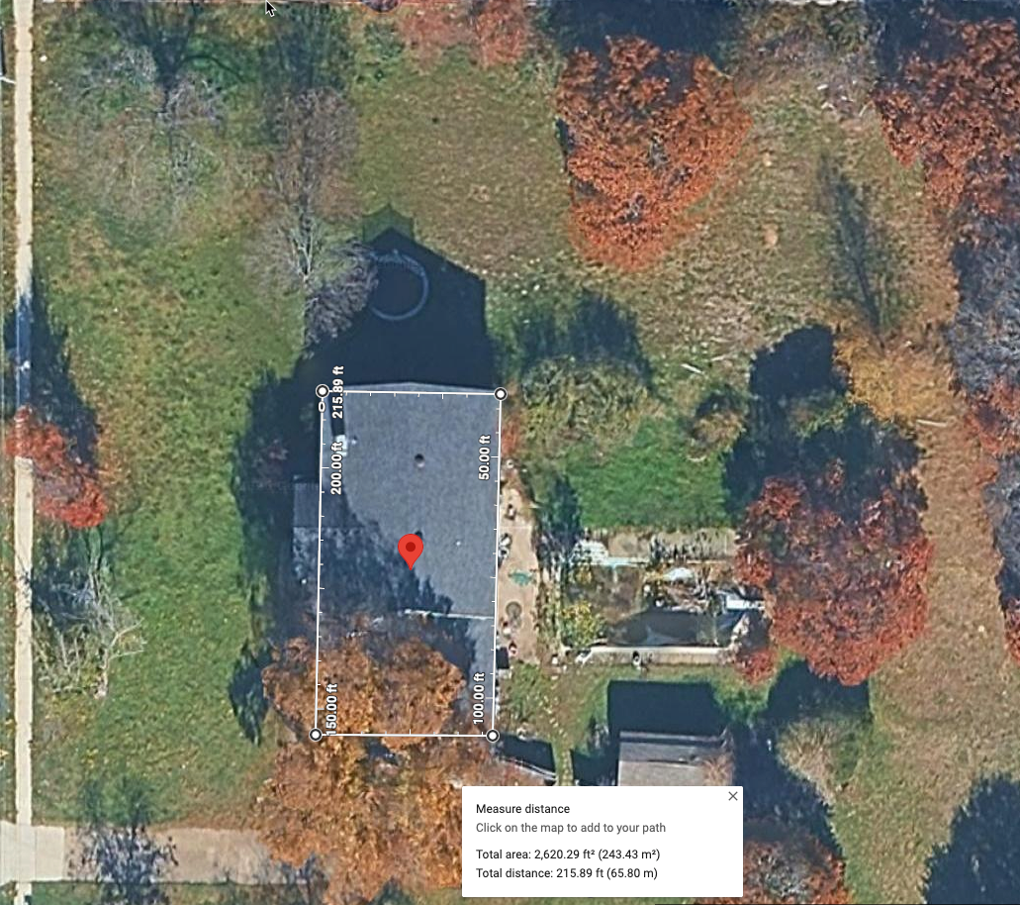
Impervious roof area converts rainfall into rapid runoff
A roof does not absorb rainfall; discharge depends on downspout layout, grading, and whether runoff is detained or routed to an approved path.
Approximate roof runoff volume
13,060
8,162
4,897
3,265
1,632
1"
2"
3"
5"
8"
Rainfall depth
≈1,630 gal
per 1 inch of rainfall on the measured 2,620 SF roof area
Roof-only calculation. Total impervious impact increases if driveway, patios, walks, and compacted fill are included.
Roof-area screenshot [9]; rainfall-volume conversion [10].
4
Notes:
This is the easiest quantitative point: the roof alone can produce more than 1,600 gallons per inch of rainfall. Ask the City to require the applicant to show exactly where this water goes, not merely that the lot is large.

Slide 5
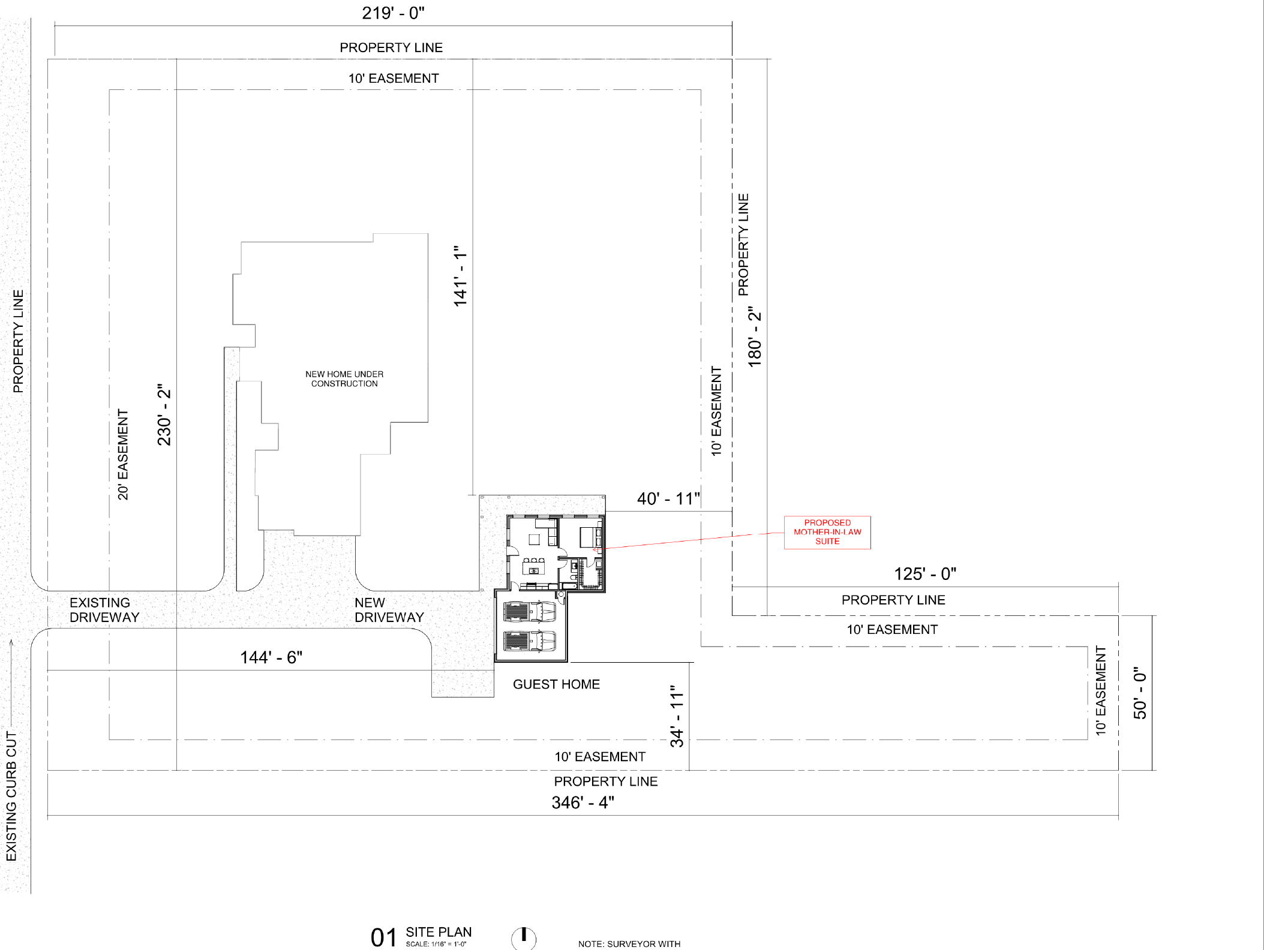
Site plan shows multiple runoff-generating changes
The accessory structure is paired with a new driveway and grading changes that need to be reviewed together.
Review items
Pre-construction vs proposed topography and grade arrows.
Downspout discharge locations and whether flow is concentrated.
Driveway cross-slope and whether it directs runoff to the street or side yards.
guest home footprint
Any fill placed near property lines, easements, or neighboring low points.
Whether runoff crosses more than two residential lots before reaching a street or drainage easement.[4]
The architectural site plan does not establish final grades or runoff routing. Residents request a separate grading/drainage review showing elevations, flow arrows, downspout discharge points, and runoff controls.[3][4][6]
Site plan: [8]. City drainage and grading criteria: [3], [4], [6].
5
Notes:
Point out the difference between an architectural site plan and a drainage plan. Residents need the latter: elevations, slopes, drainage arrows, tie-ins, and discharge points.

Slide 6
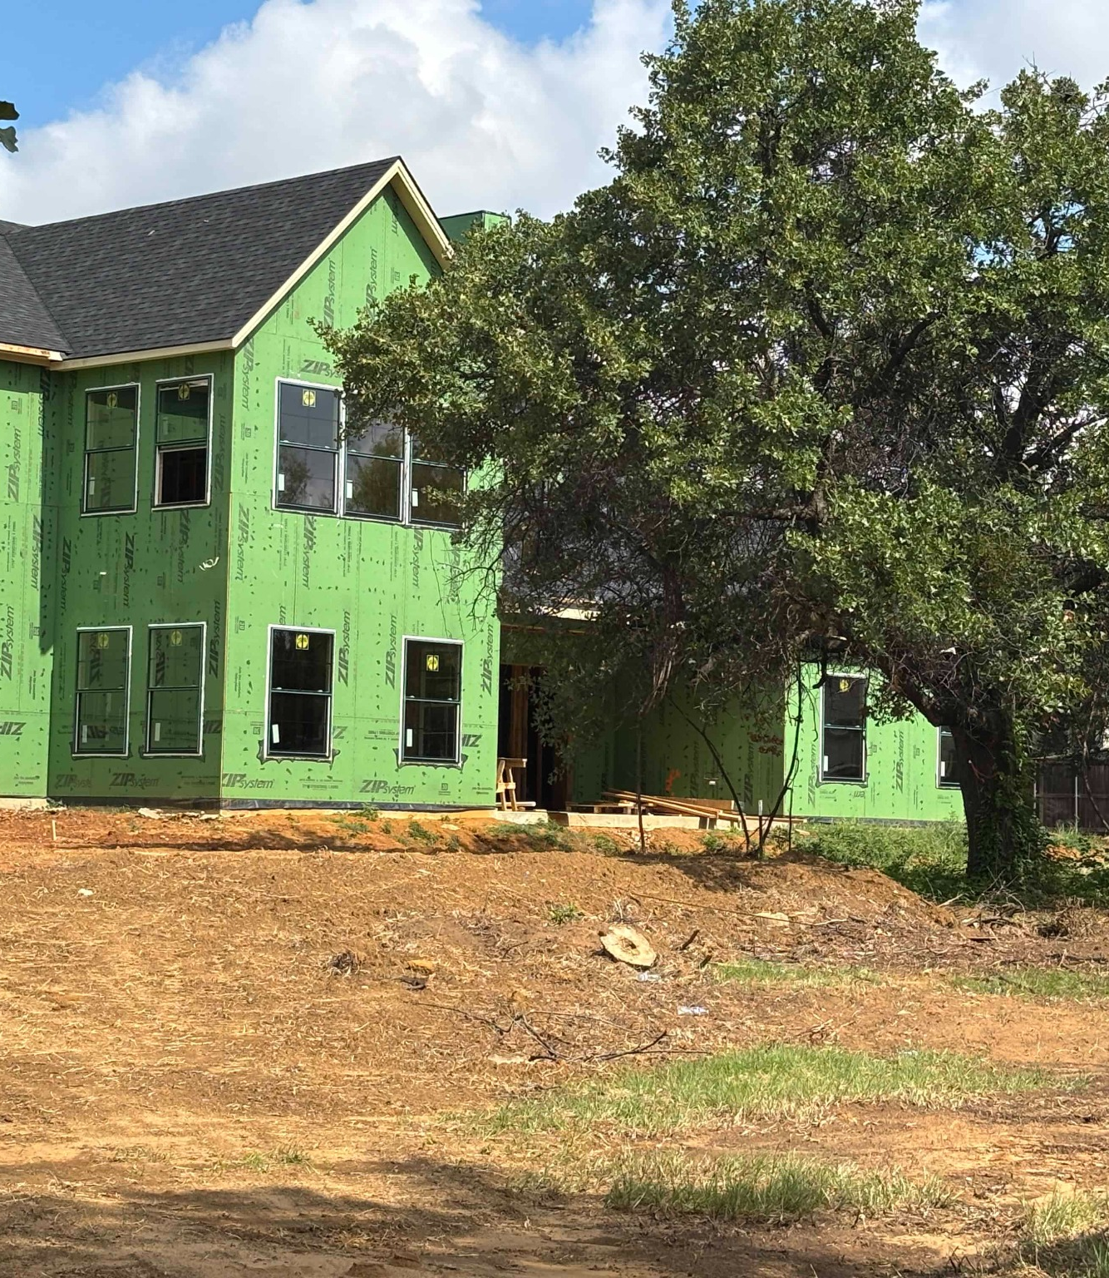
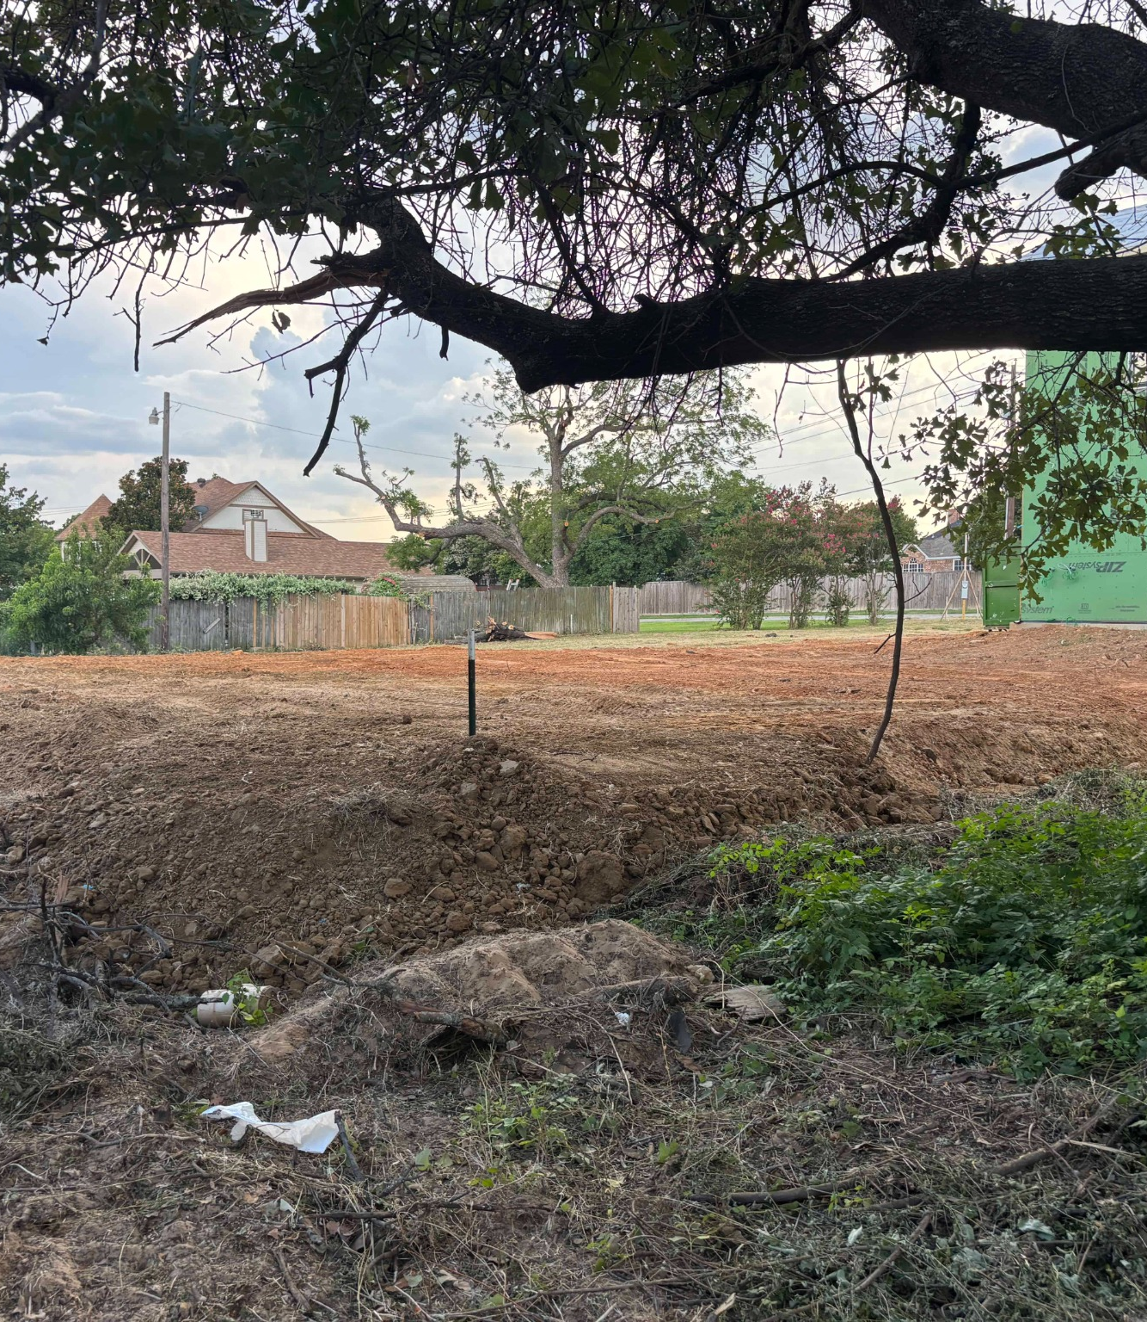
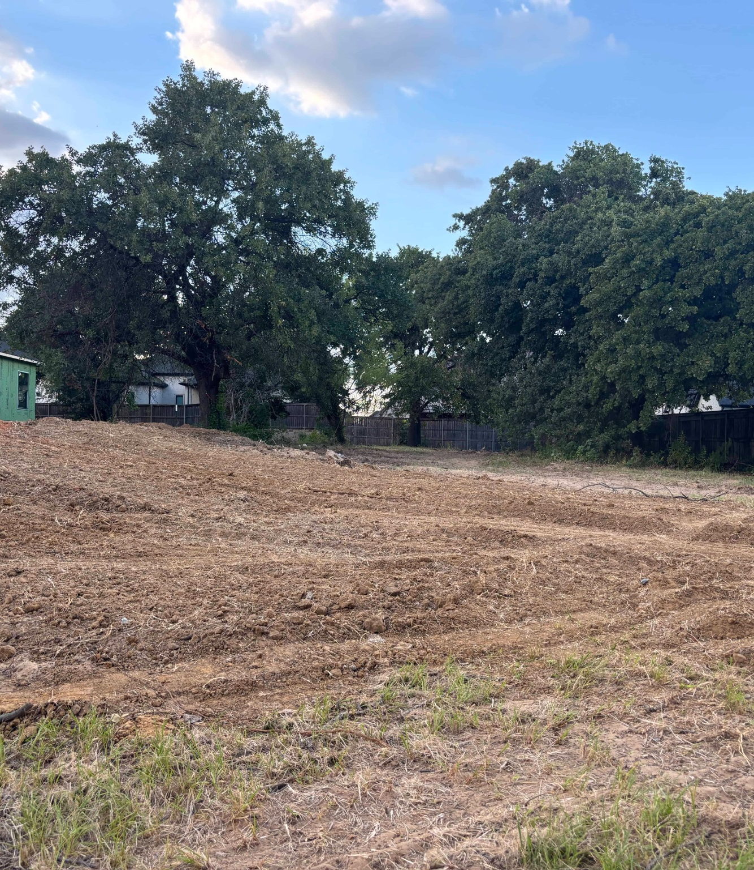
Field photographs show extensive grading and exposed soil
These photographs document current conditions; they do not replace a licensed topographic survey.
Grade change 1 — raised building pad and exposed slope near the house.
Grade change 2 — broad disturbed area with fill and altered surface contours.
Grade change 3 — visible fall from the building pad toward the side/rear yard.
Observed condition: most vegetation has been removed over a large portion of the lot, reducing temporary soil protection and making runoff paths easier to form during storms.
Resident photographs, July 2026: Reference [9].
6
Notes:
Describe only what the photographs show: disturbed soil, fill, and visible changes in slope. Do not state exact elevations without a survey.

Slide 7
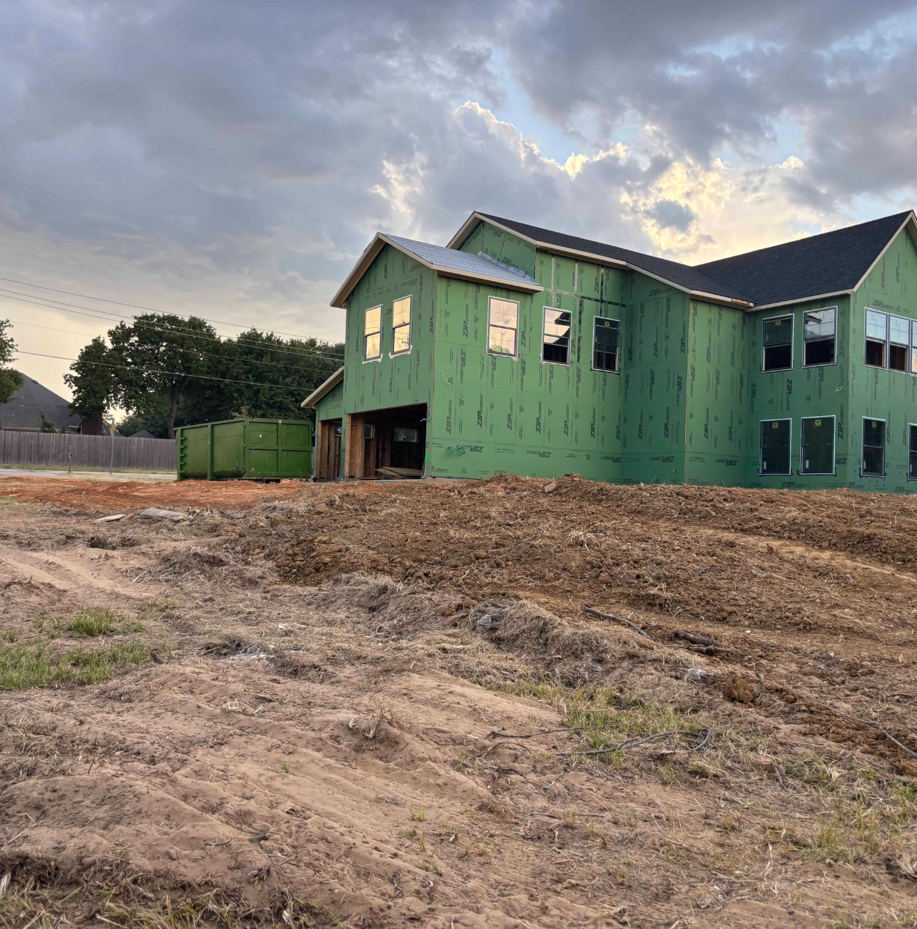
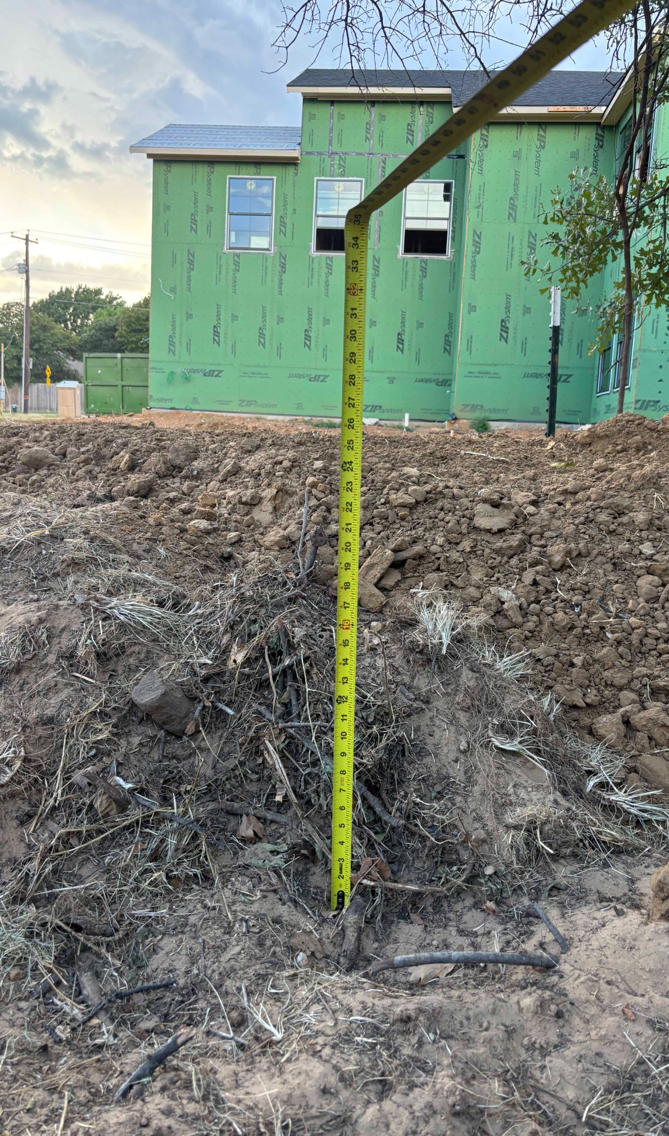
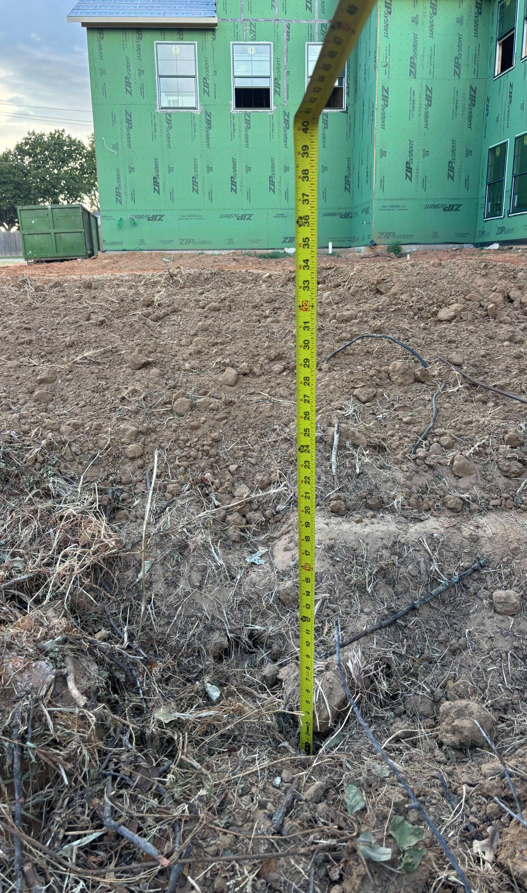
Resident measurement indicates a substantial localized grade difference
The tape photographs show an approximate vertical difference at one field location; survey elevations are required for verification.
Grade change 4 — raised pad and fill adjacent to the new structure.
Grade change 5 — 26” of dirt added.
Grade change 6 — 34” of dirt added
City verification requested: compare approved grading elevations with an independent field survey and the final as-built grading & drainage survey required before final inspection.[5]
Resident photographs: [9]. Current final as-built survey requirement: [5].
7
Notes:
The tape is evidence of a localized difference, not a parcel-wide elevation survey. Ask the City to reconcile the observed fill with approved plans and required as-built certification.

Slide 8
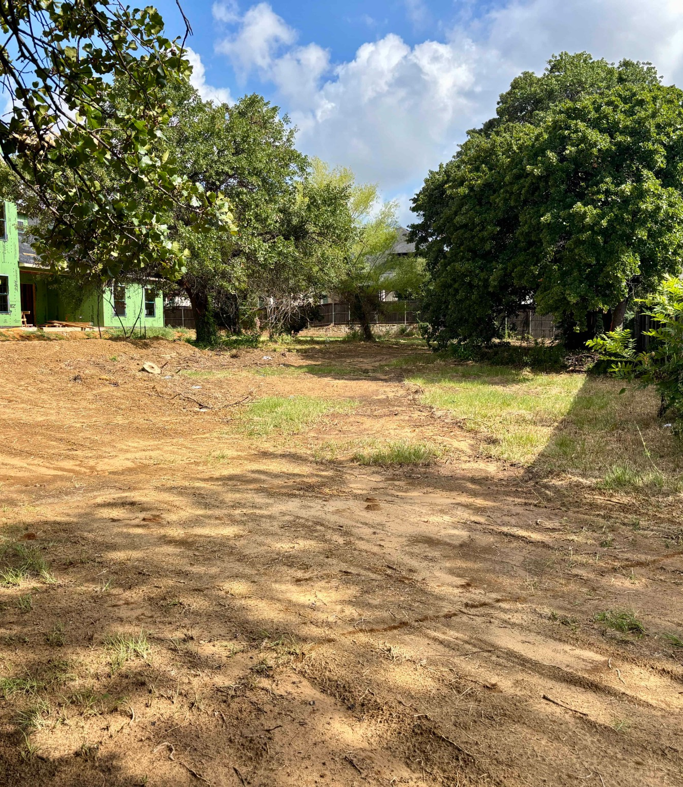
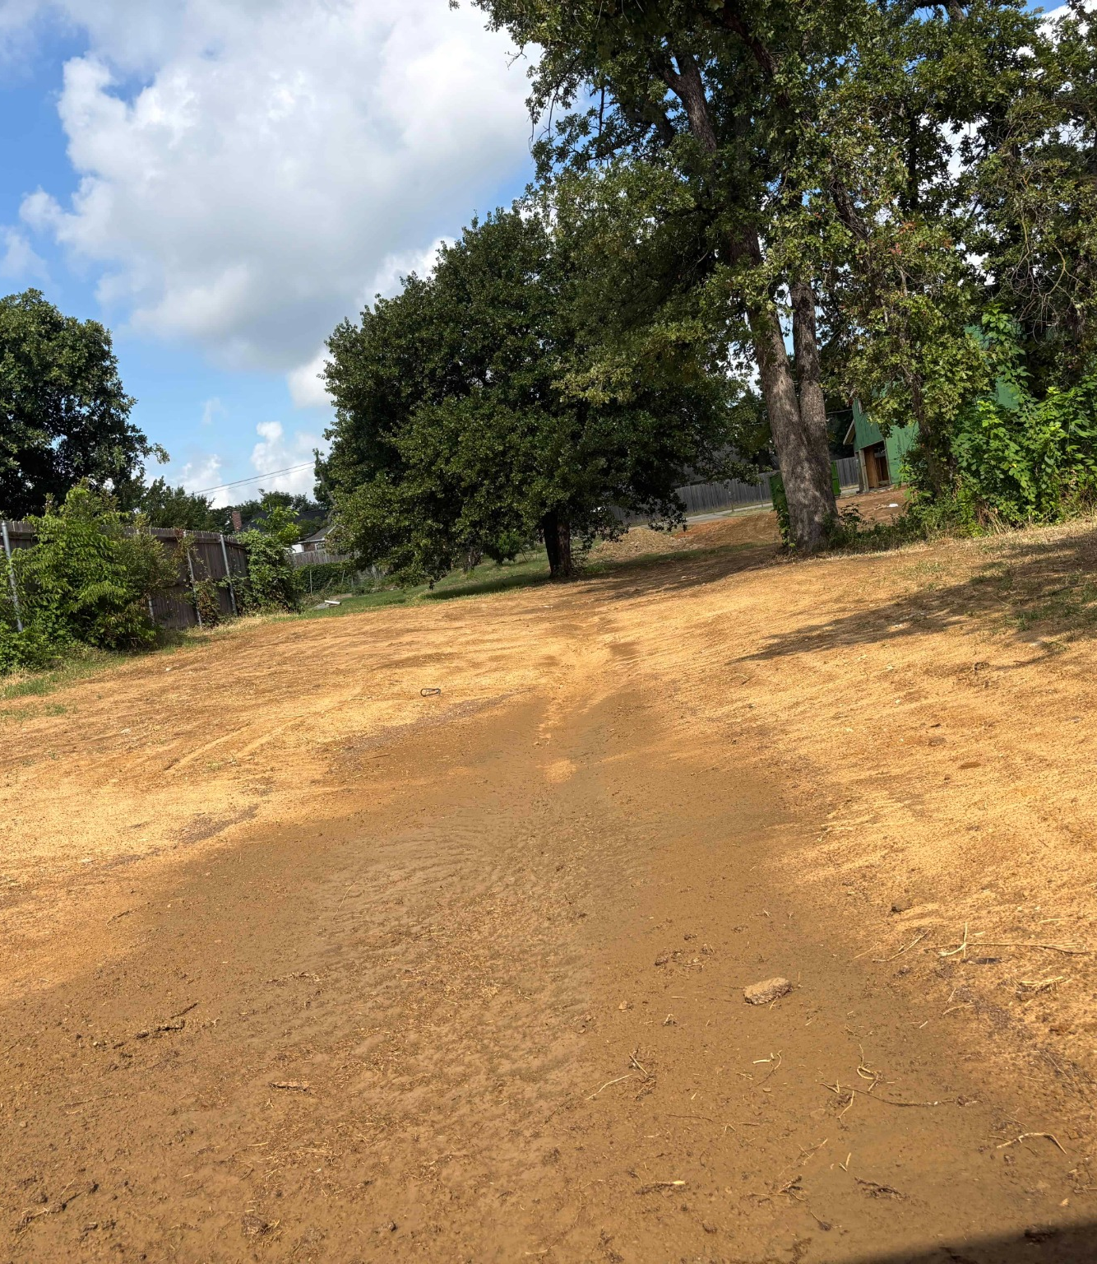
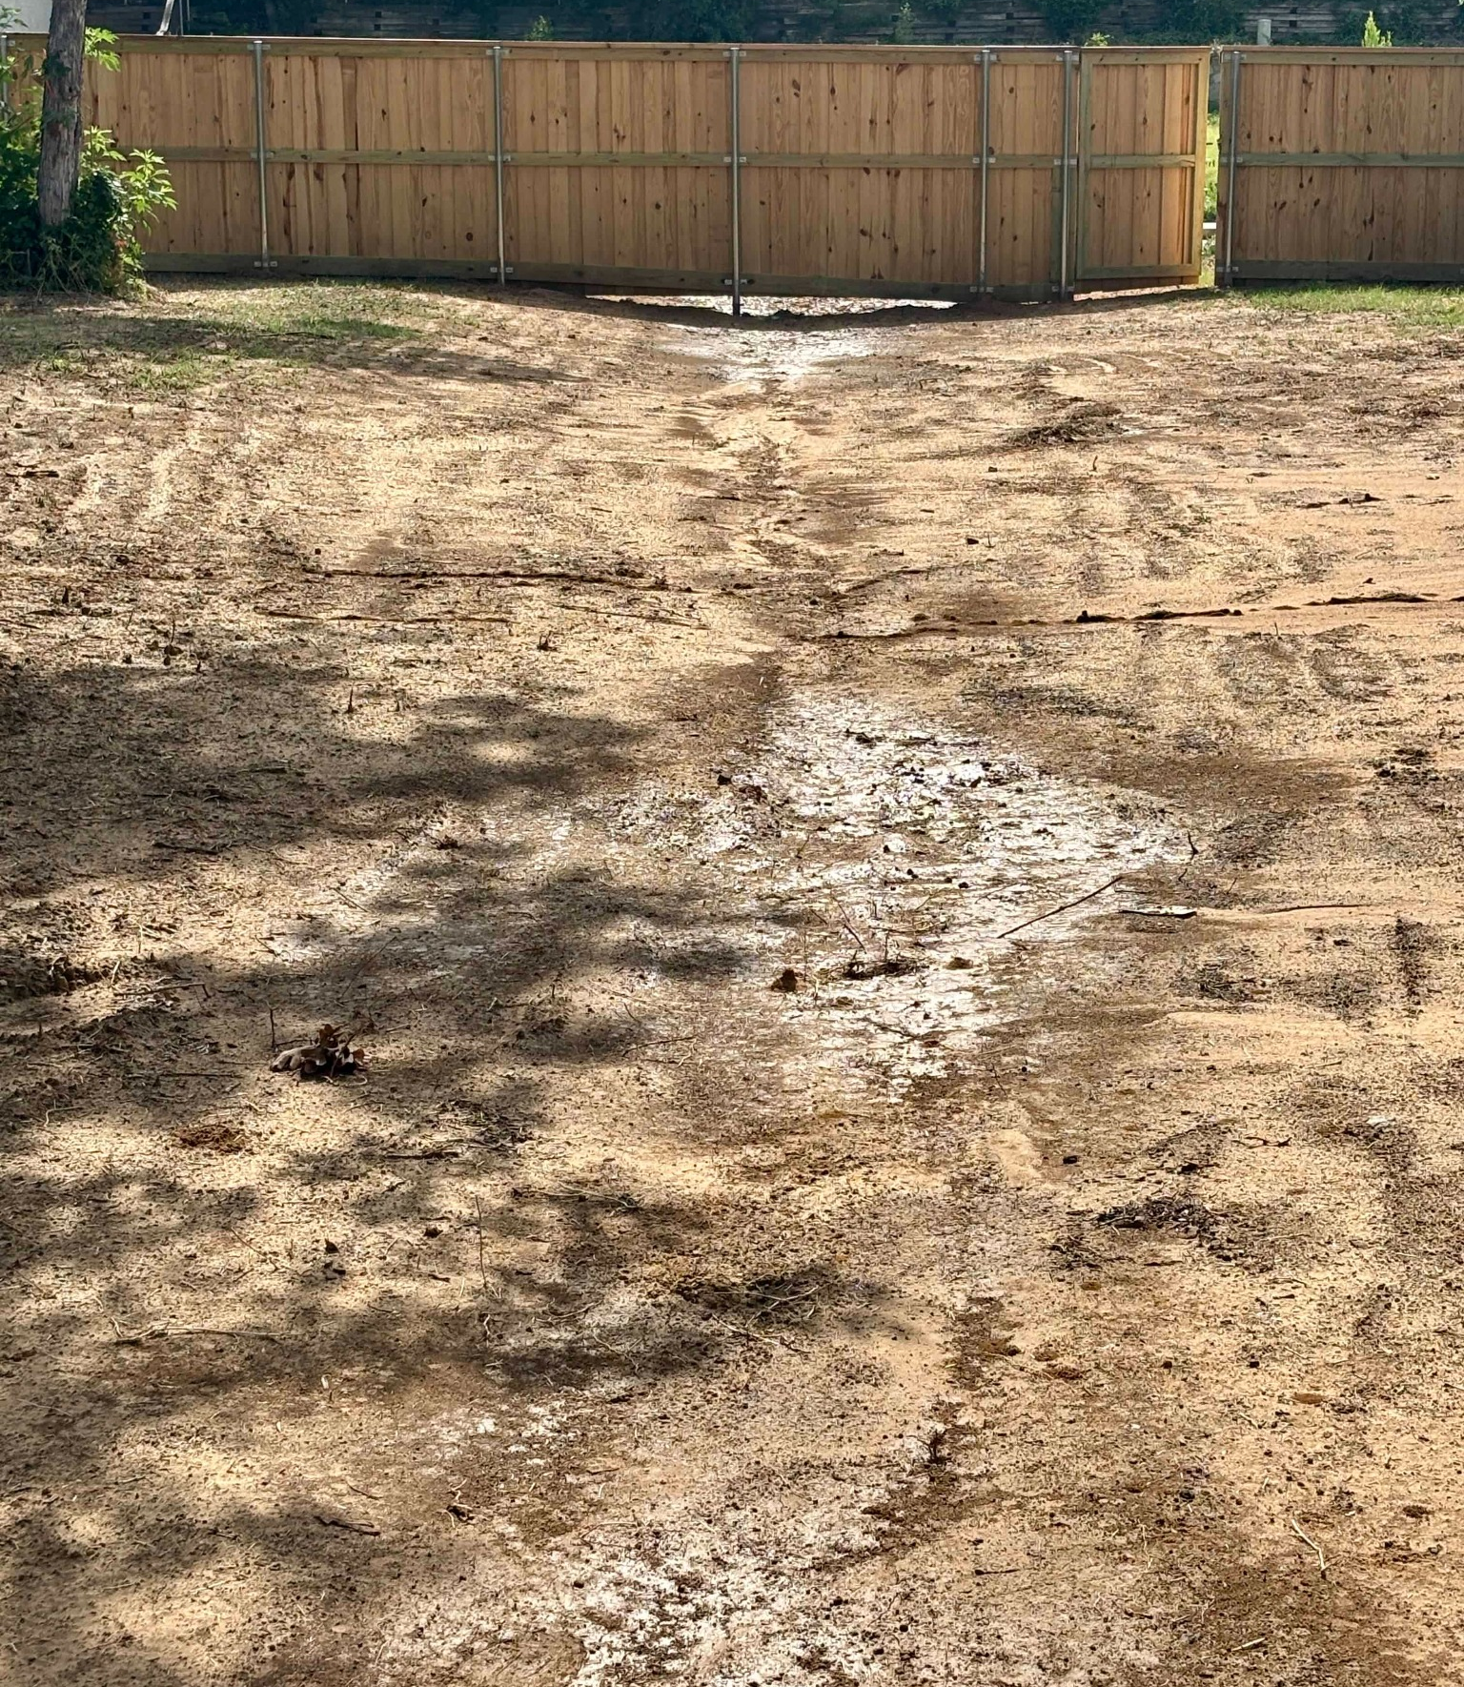
Observed runoff paths across disturbed ground
Resident photographs taken after wet conditions show visible flow concentration and erosion pathways.
Runoff 1 — broad disturbed surface and apparent channel through the yard.
Runoff 2 — wet flow path visible along compacted/exposed soil.
Runoff 3 — water appears to concentrate toward and beneath the fence line.
These images support a request to document pre- and post-construction flow direction, discharge locations, and erosion controls. The exact watershed and discharge route require professional survey/engineering confirmation.
Resident photographs, July 2026: Reference [9].
8
Notes:
Use careful language: apparent flow paths and observed wet areas. Avoid claiming a code violation solely from a photograph.

Slide 9
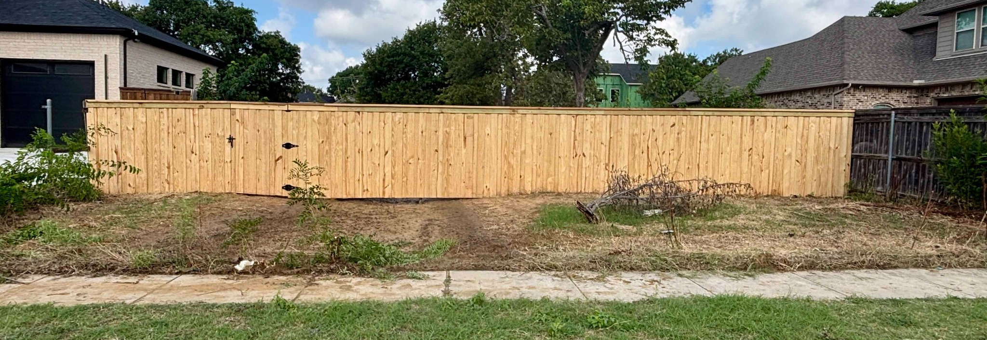
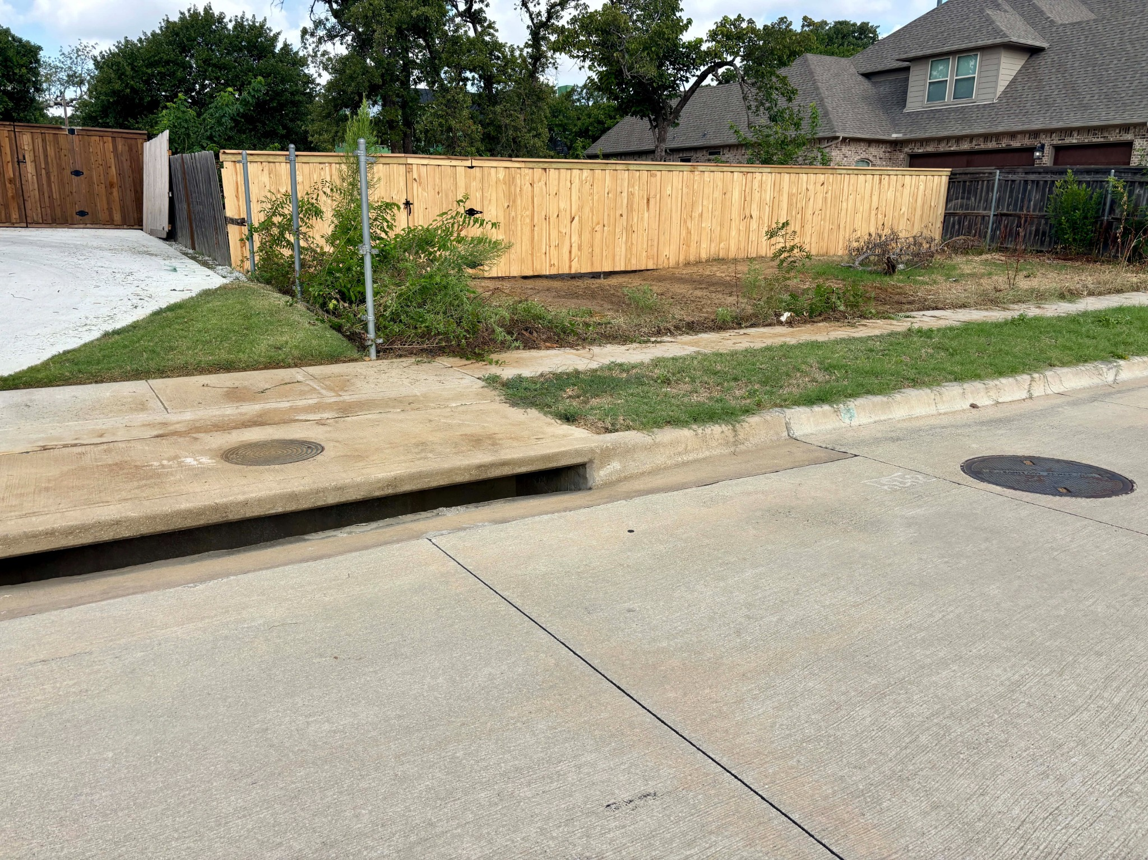
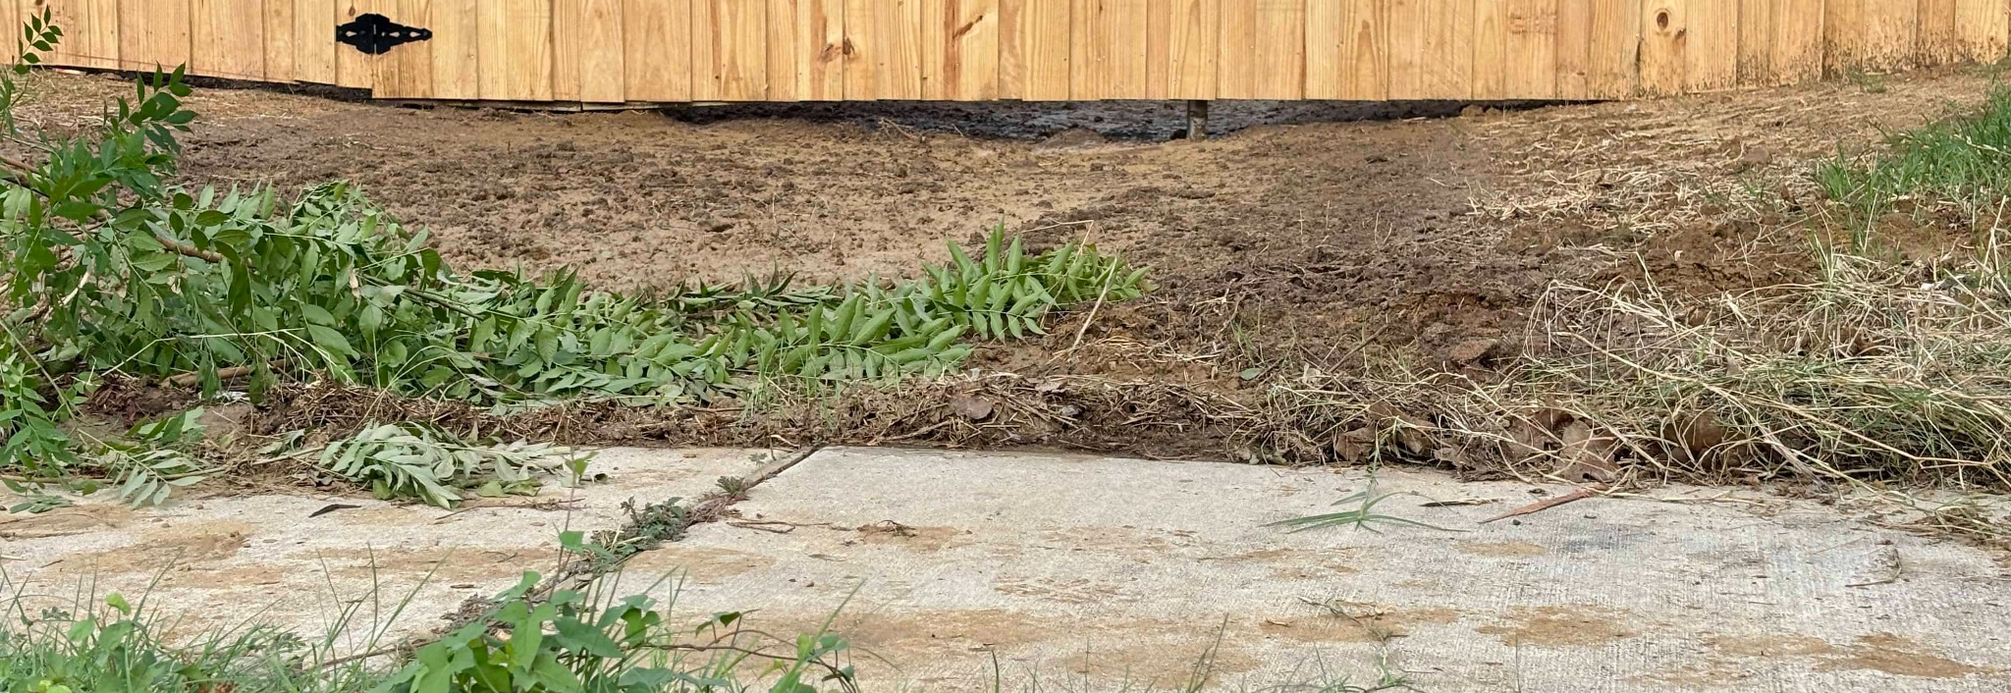
Construction runoff and storm-drain inlet protection
The nearby curb inlet makes erosion and sediment controls a practical water-quality concern.
Runoff 4 — street-side fence and disturbed soil behind it.
curb inlet
Runoff 5 — low opening and wet/eroded path beneath the fence.
Runoff 6 — nearby curb inlet / municipal storm-drain entry.
Finding: If disturbance is at least 1 acre (or part of a larger common plan), NRH requires an approved stormwater plan and BMPs.[1] At applicable sites, the Code requires inlet/outfall protection and non-erosive conveyance.[6] The PWDM lists inlet protection, silt fence, construction entrances, and BMP maintenance.[3] TCEQ uses the same acreage threshold.[7]
Legal applicability depends on verified disturbed acreage and project status. Refs: [1], [3], [6], [7], [9].
9
Notes:
Answer the resident question precisely: yes, the City has construction stormwater and inlet/outfall protection requirements, but the formal SWP3/BMP trigger depends on disturbed acreage or a larger common plan. Ask staff to verify the disturbed acreage and inspect the controls.

Slide 10
Potential failure mode: concentrated flow to adjacent lots
The risk is magnified if regrading and roof leaders convert broad sheet flow into focused runoff.
What can go wrong
Roof leaders discharge toward side or rear yards instead of an approved drainage path.
Fill creates a berm that blocks historical flow from neighboring properties.
possible concentrated runoff direction
Driveway pavement becomes a channel that bypasses soil absorption.
Erosion/sediment reaches neighboring yards during construction before vegetation is restored.
Residents are asking for proof of flow direction and capacity, not assumptions.
Conceptual only
Conceptual illustration based on resident aerial imagery [9]; City conveyance criteria [4], [6].
10
Notes:
Make it clear that arrows are conceptual. They illustrate why downspout locations and grades must be documented. The site should not divert, concentrate, or block drainage onto neighboring property.

Slide 11
What current City requirements say
Every legal statement below is tied to the numbered references at the end of the presentation.
Construction stormwater threshold [1]
Recommended verification sequence
Before construction disturbing at least 1 acre—or less than 1 acre as part of a larger common plan—the City Code requires an approved stormwater prevention plan. Applicable projects must use approved BMPs and maintain them.
1
Verify disturbed acreage
and applicable stormwater plan [1][7]
Post-construction runoff review [6]
Applicable sites must follow the Public Works Design Manual or an engineer-designed plan approved by Public Works. The department may impose additional controls when hydrologic or topographic conditions warrant.
Compare approved and
current grades / runoff paths [4][6]
2
Residential grading / downstream impact [4]
Inspect erosion, sediment,
inlet and outfall controls [1][3][6]
The PWDM states residential lot grading should not route runoff across more than two lots before reaching a street or drainage easement, and downstream/adjacent effects must receive proper consideration.
3
4
Require and review final
as-built survey before final [5]
Final as-built verification [5]
Current building-code amendments require a licensed-surveyor grading & drainage survey before final inspection approval for all new construction and other features that may affect City drainage designs.
The presentation does not determine whether a violation occurred. It asks the City to verify which requirements apply, inspect current controls, and document compliance.
City and state authorities: References [1], [3], [4], [5], [6], [7].
11
Notes:
This is the core legal slide. Keep the threshold caveat clear. The parcel is 1.319 acres, but the regulatory trigger is disturbed acreage, not parcel size alone.

Slide 12
Requests to the City
The requested conditions should be measurable and enforceable before final approval or occupancy.
1
Require an updated grading & drainage plan
Include existing/proposed contours, drainage arrows, fill areas, driveway grades, and discharge points.
2
Quantify added impervious surface
Roof, covered porches, garage, driveway, walkways, patios, and compacted construction access.
3
Route runoff to an approved path
Show downspout leaders, swales, drains, or detention so runoff is not concentrated on adjacent lots.
4
Confirm final as-built verification [5]
Enforce the current requirement for a licensed-surveyor grading & drainage survey before final inspection.
5
Inspect and maintain erosion controls [1][3][5]
Verify BMPs, inlet/outfall protection, stabilization, and corrective action while soil remains disturbed.
Resident position: approval should be conditioned on no adverse drainage impact to neighboring lots and field-verified compliance after construction.
Requested conditions are grounded in References [1], [3], [4], [5], and [6].
12
Notes:
This is the most important slide for testimony. Read the five requests cleanly and ask the City to place them in the record as conditions or staff requirements.

Slide 13
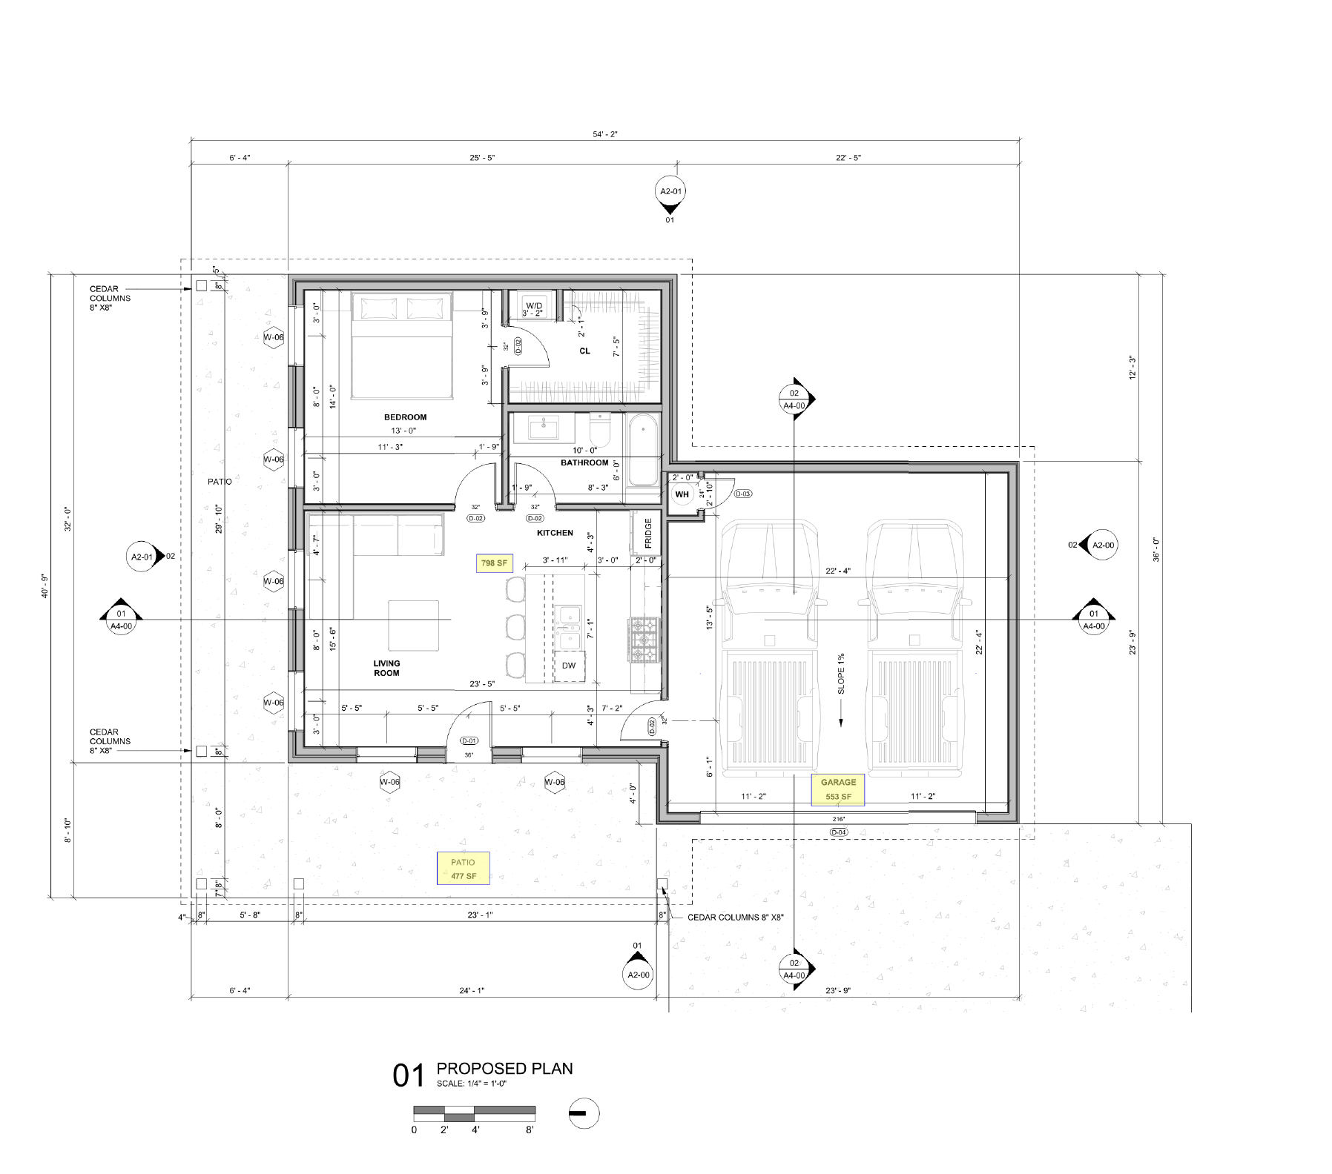
Open questions for staff and applicant
These questions convert resident concern into reviewable technical items.
Questions to be Answered:
What is the verified total disturbed acreage, and do NRH/TCEQ stormwater-plan requirements apply?[1][7]
Has Public Works reviewed a grading/drainage plan for the structure, driveway, fill, and runoff routing?[4][6]
What is the pre-construction drainage pattern, and what changes after construction?
Where will each roof downspout discharge?
Does the plan include detention, swales, area drains, or other conveyance features?
How will the final as-built Grading & Drainage Survey required by the current building code be reviewed?[5]
What erosion, sediment, inlet, and outfall controls are installed, inspected, and maintained?[1][3][6]
A complete answer should identify flow direction, elevation control, capacity, and maintenance responsibility.
Site plan: [8]. Applicable review and control questions: [1], [3], [4], [5], [6], [7].
13
Notes:
This slide can be used as a script at the hearing. The goal is to get staff/applicant to answer in technical terms rather than general assurances.

Slide 14
Closing message
Residents support a clear, enforceable drainage review before the project moves forward.
Requested Action
Before approval: require a documented drainage solution that prevents concentrated runoff, preserves approved grading intent, and is verified by an as-built survey.
Draft public comment deck. Photographs are observations; final findings require City review and licensed survey/engineering.
14
Notes:
Close with a clear, reasonable ask. The City has tools to require review and verification; residents want those tools used before the project creates irreversible drainage impacts.

Slide 15
Numbered references — City ordinances and design requirements
Bracketed numbers throughout the deck refer to these sources. Accessed July 14, 2026.
[1]
NRH Code of Ordinances, Chapter 102, Article VII, §§102-353–356 — stormwater plan threshold, BMP implementation/approval, and maintenance.
[2]
NRH Code of Ordinances, Chapter 102, Article VII, §§102-357–359 — notices of violation, stop-work authority, and penalties.
[3]
NRH Public Works Design Manual — erosion-control plans; construction entrance, silt fence and storm-drain inlet protection; SWP3 implementation and BMP maintenance.
[4]
NRH Public Works Design Manual — residential lot grading, off-site/adjacent drainage impacts, single-lot grading permits, and revised grading plans.
[5]
NRH Ordinance No. 3947 (2026 building-code amendments), §107.6 Final as-built grading surveys; R108.7 item 7 regarding failure to maintain erosion control.
[6]
NRH Code of Ordinances, Chapter 102, Article VIII, §§102-371–378 — applicability, permits, design criteria, additional runoff controls, and inlet/outfall protection.
Primary online sources
ecode360.com/46059211 | ecode360.com/46059296 | ecode360.com/46068975 | nrhtx.com/DocumentCenter/View/21964
The online code is a reference copy; the City Secretary maintains the official code record.
15

Slide 16
Numbered references — State permit, case documents, and photographs
Supporting material used for calculations, exhibits, and field observations.
[7]
Texas Commission on Environmental Quality, Construction General Permit TXR150000 and current construction-stormwater guidance — coverage and SWP3 requirements for disturbances of at least 1 acre or qualifying common plans.
[8]
City of North Richland Hills case materials supplied for ZC26-0169: Property Owner Notification, Location Maps, and Site Plan Exhibits.
[9]
Resident aerial screenshots, roof-area measurement, and field photographs labeled “grade changes 1–6” and “runoff 1–6,” supplied July 2026.
[10]
Rainfall-volume conversion used on Slide 4: 1 inch of rain over 1 square foot equals approximately 0.623 gallons.
State source
tceq.texas.gov/permitting/stormwater/construction
Important applicability note: the parcel area is 1.319 acres, but the City/TCEQ stormwater-plan threshold is based on the area actually disturbed (or a larger common plan), which must be verified by staff or the operator.[1][7]
Photographs document observed conditions; they do not independently establish elevations, property boundaries, or code violations.
16

